Slide 1
An Investigation into the Factors Driving Housing Price Growth in the New York Boroughs
Illidan’s Ingenious Infrastructure
Notes:
Will

Slide 2




Introduction to Team
Will Crocker
Nicholas Fenech
Prateek Bardhan
Illidan
(Will’s cat)
Notes:
All of us

Slide 3
Introduction
This project focused on investigating the New York City housing market
Attempted to determine how various factors could impact prices
Examined trends between sale prices and several different contributing features
Quantified the extent of the drop in housing affordability
Notes:
Will

Slide 4
Sources
NYC Open Data
Contains data from the past 20 years of housing sales by borough
Also shows many useful descriptive factors about each property
https://www.nyc.gov/site/finance/taxes/property-annualized-sales-update.page
Census Bureau
American Community Survey 5-Year
Survey collects information on housing attributes, transportation, demographics, and economic factors
Contains information from federal to local municipality levels
https://www.census.gov/data/developers/data-sets/acs-5year.html
Notes:
Prateek and Nick

Slide 5
Technologies Utilized to Investigate Housing Prices
Microsoft Azure
Databricks
Kafka
SQL Database
PowerBI
Machine Learning Algorithm
Python and PySpark
Notes:
Will

Slide 6
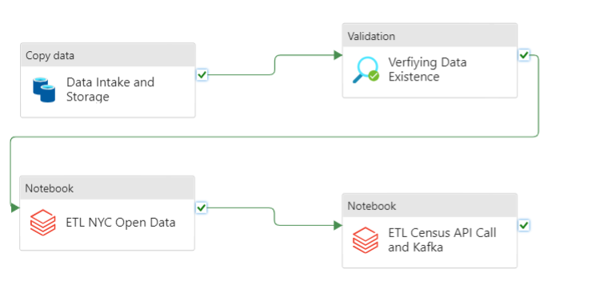
ETL Diagram
Notes:
Nick

Slide 7
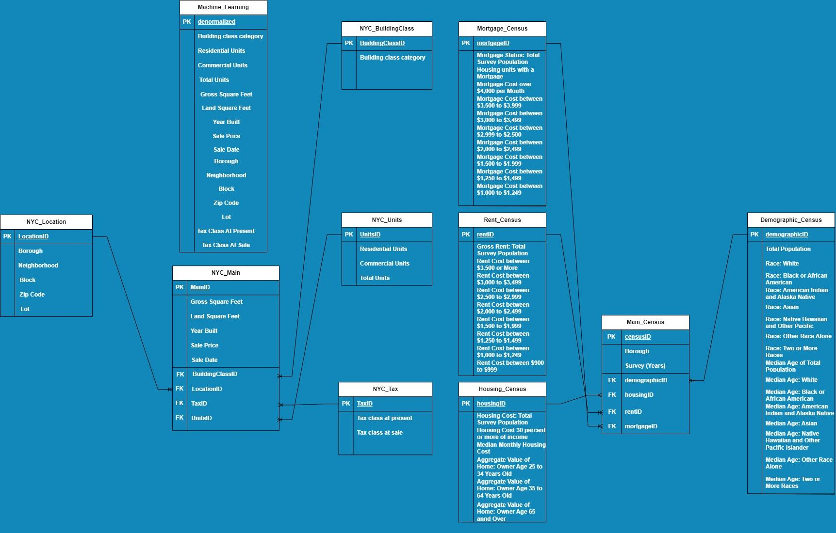
ERD for SQL Database
Notes:
Nick

Slide 8
Machine Learning
Goal: use machine learning techniques to predict sale prices
XGBoost is an open-source software library which uses gradient-boosted decision trees to perform regression and classification
We used the following factors in our model:
Year of sale
Land square feet
Gross square feet
Year built
Total units
Borough
Tax class
Neighborhood
Building class category
Notes:
Prateek

Slide 9
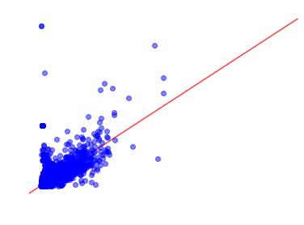
Machine Learning
We trained our model on data from 2003 to 2017 and used it to attempt to predict sale prices from 2018 to 2022
Training set accuracy score: 0.80
Test set accuracy score: 0.50
This is disappointing!
Let’s see if we can find out why…
Notes:
Prateek

Slide 10
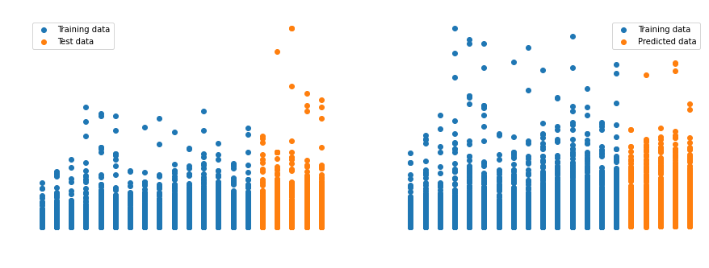
Machine Learning
Notes:
Prateek

Slide 11
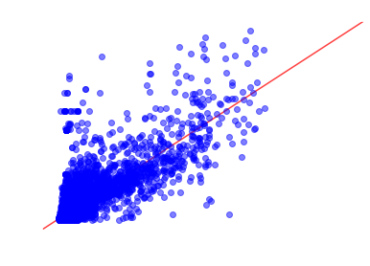
Machine Learning
Removed sale prices greater than $30,000,000
New training set accuracy score: 0.78
New test set accuracy score: 0.64
Not perfect, but much better!
Notes:
Prateek

Slide 12
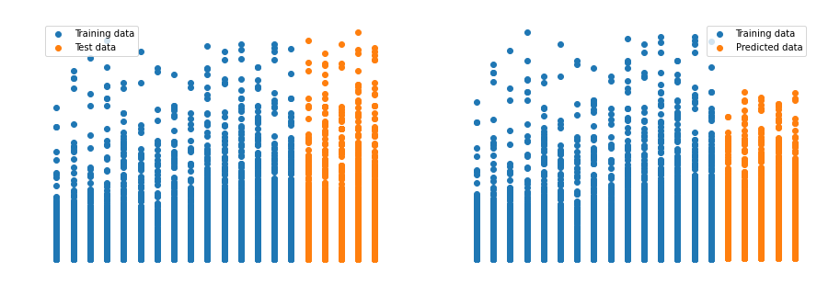
Machine Learning
Notes:
Prateek

Slide 13
Machine Learning
Split the test data to see the accuracy by individual year
2018 test set accuracy score: 0.69
2019 test set accuracy score: 0.65
2020 test set accuracy score: 0.59
2021 test set accuracy score: 0.64
2022 test set accuracy score: 0.64
These results match with our expectations!
2018 is the highest since it directly follows the training set
2020 is the lowest, with COVID-19 the housing market would be harder to predict
Notes:
Prateek

Slide 14
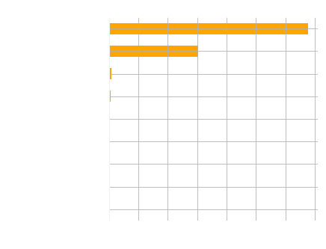
Machine Learning
Feature importance shows the biggest contributing factors
Borough and neighborhood
Notes:
Prateek

Slide 15
Dashboard
Onto Power BI Online
Notes:
Will and Nick

Slide 16
Conclusions
Housing Prices have almost tripled across the last 20 years
Neighborhood is the one of the biggest contributing factors to price
More people are paying higher rent
The majority of home value is owned by middle aged individuals
Notes:
Will

Slide 17
Questions?
Please feel free to provide feedback by scanning the QR Code to the right!

Slide 18
Thank you for listening!

